Slide 1


Titolo presentazione sottotitolo
SAFESTREETS
Requirements Analysis and Specification Document & Design Document
Milano, XX mese 20XX

Slide 2

Firma convenzione Politecnico di Milano e Veneranda Fabbrica del Duomo di Milano
RASD
Goals of the system
Phenomena
Domain Assumptions
Requirements
Use Cases
Alloy Model
Aula Magna – Rettorato
Mercoledì 27 maggio 2015

Slide 3
Goal of the system
G3: Store relevant info about the violation in the data warehouse.
G4: Assist authorities in the process of law enforcement through automatic ticket compilation and elaboration of relevant statistics data.
G5: Guarantee security:
allow discarding of invalid reports;
avoid unauthentic officer registrations;
block people who came in possession of an officer’s device to cause any damage;
ban users who abuse of the violation reporting system.
Davide Cocco – Gasperini Marco 2019/2020

Slide 4
Phenomena
PHENOMENON | SHARED | WHO CONTROLS IT?
Occurrency of traffic violation. | No | World
Filing a violation report. | Yes | World
Creation of traffic tickets. | No | Machine
Presentation of relevant data about violations and offenders. | Yes | Machine
Davide Cocco – Gasperini Marco 2019/2020

Slide 5
Domain Assumptions
D3: At least one of the city’s authorities’ server is always online to process reports.
D9-D14: Authorities correctly receive the great majority of reports and discard most of the invalid ones.
D11: Officers only sign correct tickets and always check the license plate matches with the reported one.
D15: Every registered officer’s signature is stored at the authority in an image file.
Davide Cocco – Gasperini Marco 2019/2020

Slide 6
Requirements
R6: Implement a function in the authority’s client which allows personnel to validate or invalidate reports.
R7-R9: Implement a supervised learning algorithm server-side which scans the multiple frames sent by the user to recognize the license plate, that must be accurate at least 99% of the times.
R11: Store the report info in the DW everytime it is confirmed to be valid.
R17-R18: update every actor’s map with the HFVZs every 30 seconds and only the authorities’ and officers’ maps with the new reports and repeat offenders' lists in real time.
R22: Officers can only allow automated ticket emission by entering their secret pin.
Davide Cocco – Gasperini Marco 2019/2020

Slide 7
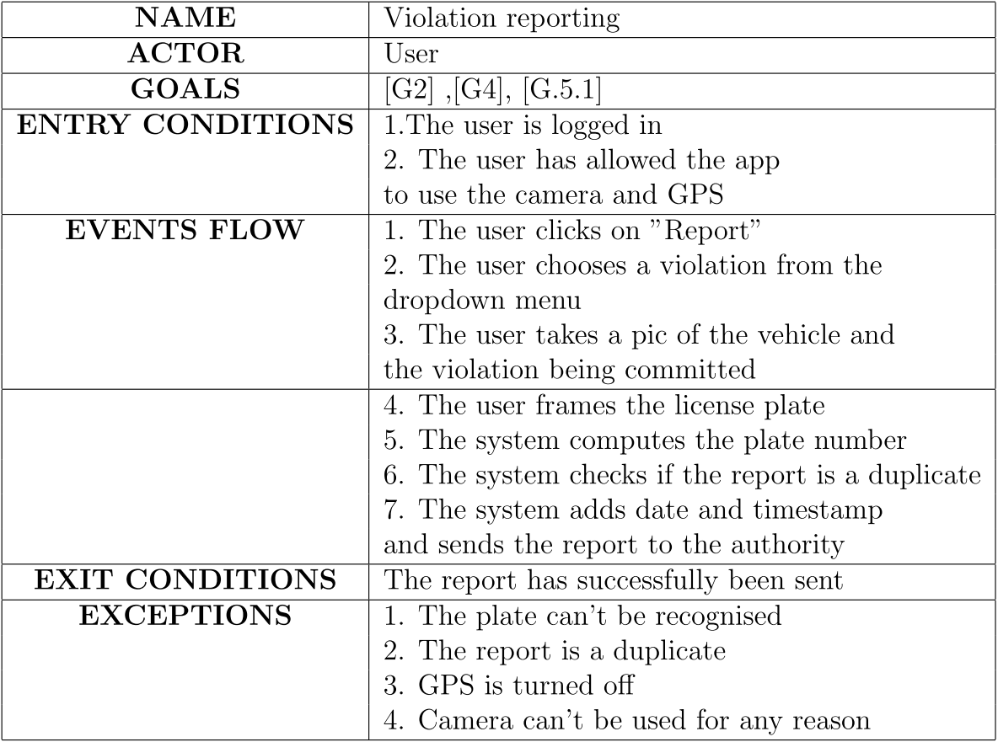
Use Cases
Davide Cocco – Gasperini Marco 2019/2020

Slide 8
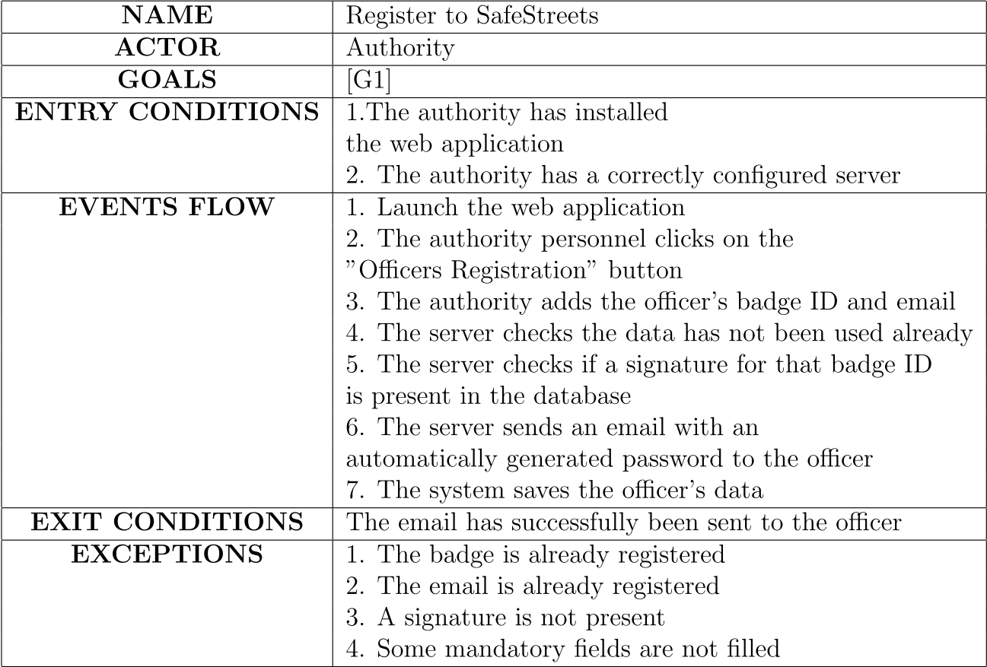
Use Cases
Davide Cocco – Gasperini Marco 2019/2020

Slide 9
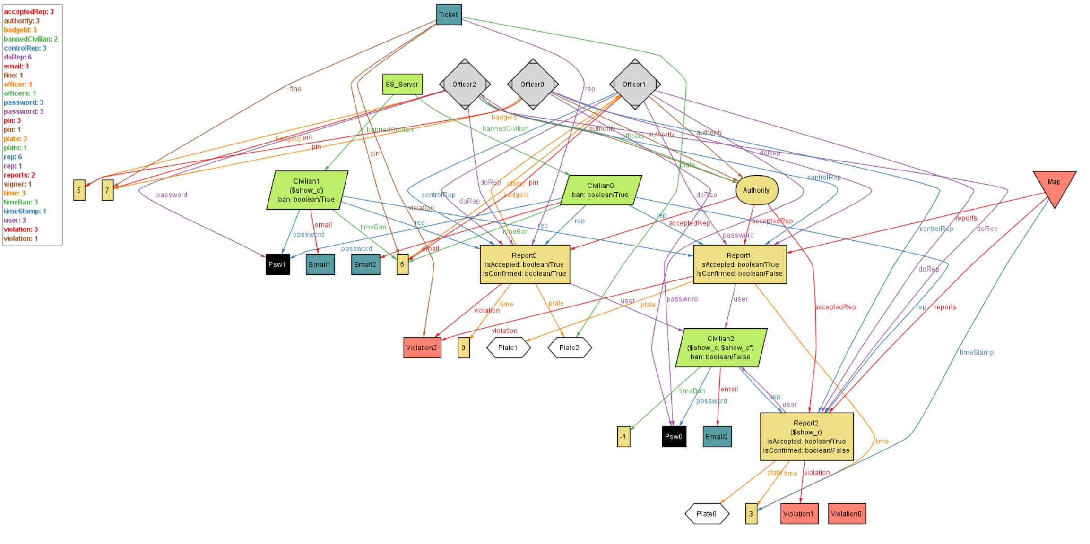
Davide Cocco – Gasperini Marco 2019/2020

Slide 10
Firma convenzione Politecnico di Milano e Veneranda Fabbrica del Duomo di Milano
DD
Components
Components Interfaces
Runtime View
Architectural Styles & Patterns
Implementation, Integration and Testing
Aula Magna – Rettorato
Mercoledì 27 maggio 2015

Slide 11
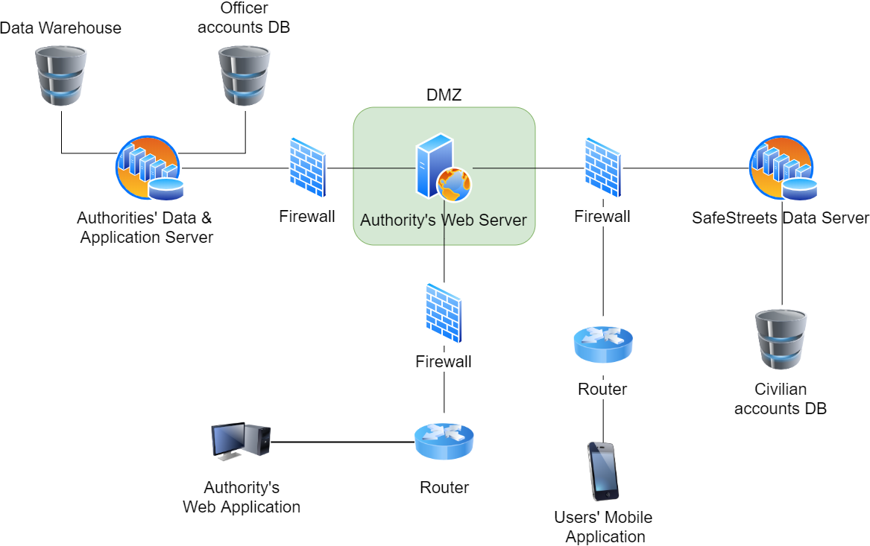
Components
Davide Cocco – Gasperini Marco 2019/2020

Slide 12
Components Interfaces
Maps API
GPS API
REST API
DBMS API
E-Mail API
Davide Cocco – Gasperini Marco 2019/2020

Slide 13
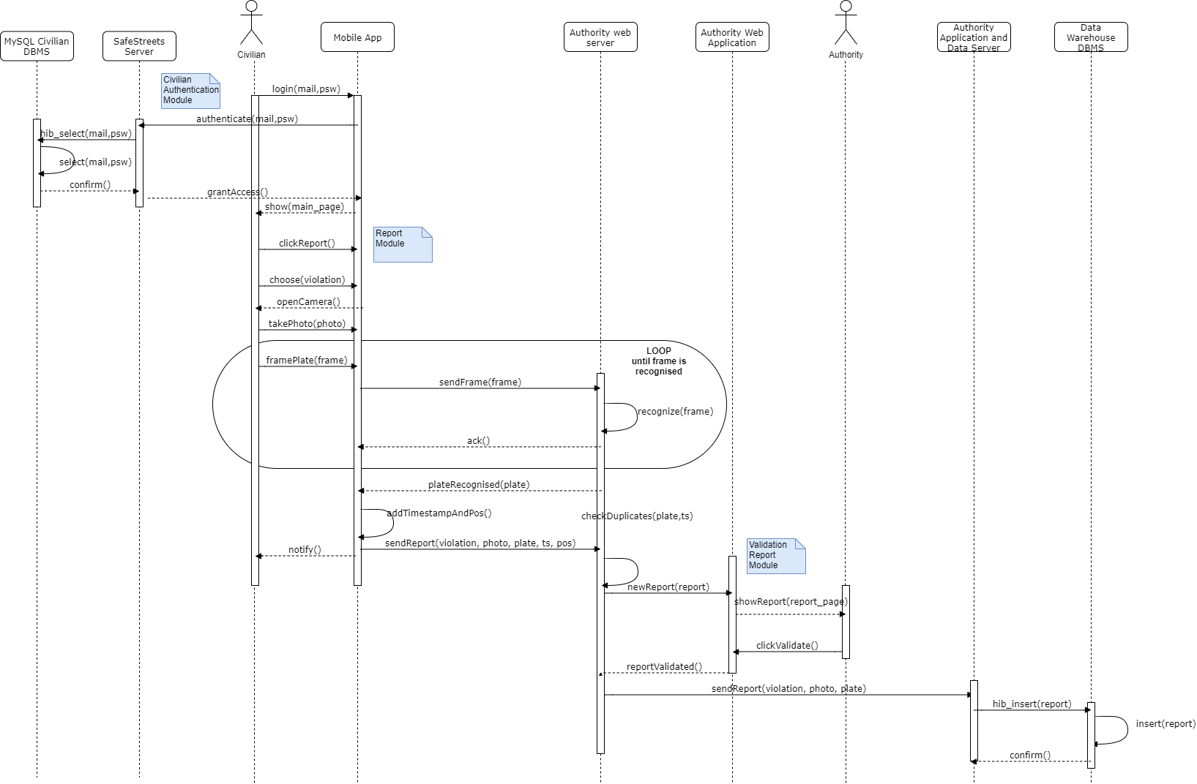
Runtime View – Civilian Report
Davide Cocco – Gasperini Marco 2019/2020

Slide 14
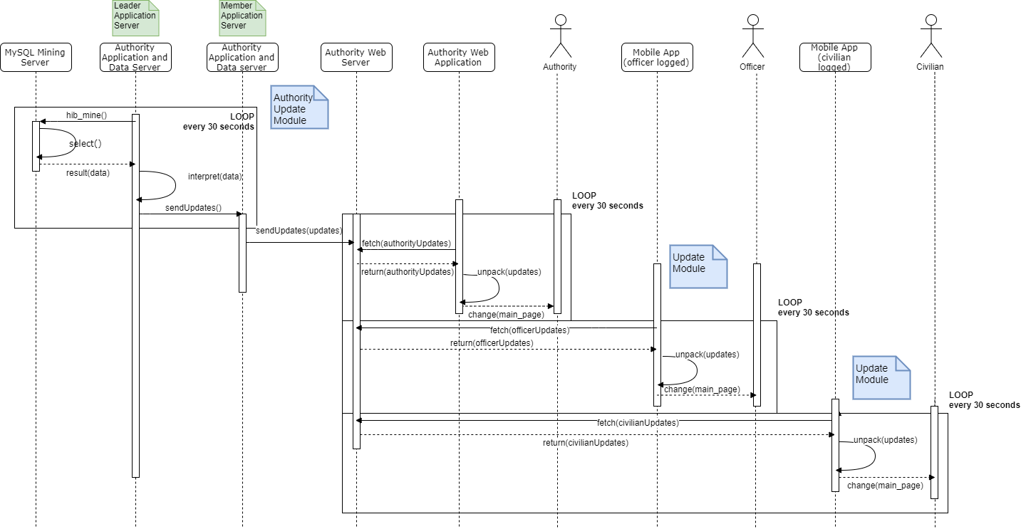
Runtime View – Update Sending
Davide Cocco – Gasperini Marco 2019/2020

Slide 15
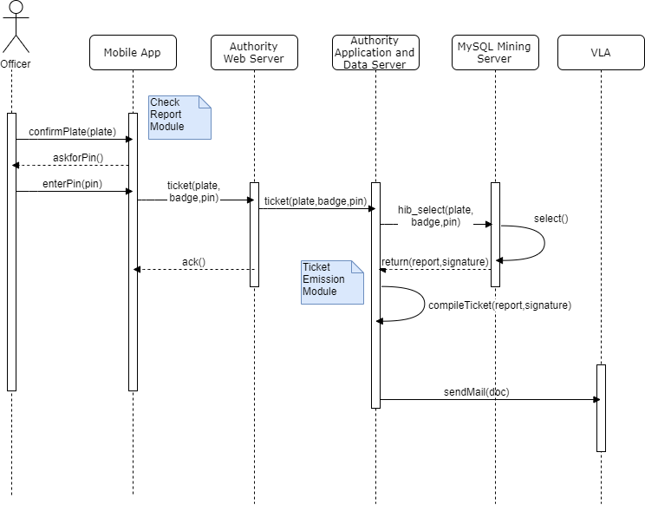
Runtime View – Automated Ticket
Davide Cocco – Gasperini Marco 2019/2020

Slide 16
Architectural Styles & Patterns
RAPS & RACS: for the SafeStreets’ Server and the Authorities’ Server.
MVC: for the software architecture.
DB Access Strategy: to handle distributed transaction and mutual exclusion.
Update production and propagation strategy.
Davide Cocco – Gasperini Marco 2019/2020

Slide 17
Implementation & Integration
Three phases of development based on importance of functionalities:
Basic compontents: functionalities required to handle registrations and violation reporting;
Ticket emission components;
Data Mining components: for report data warehousing and updating the clients.
Davide Cocco – Gasperini Marco 2019/2020

Slide 18
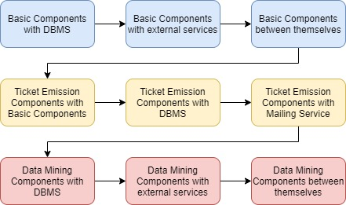
Implementation & Integration
Davide Cocco – Gasperini Marco 2019/2020

Slide 19
Davide Cocco – Gasperini Marco 2019/2020

